Slide 1
Caltech101
Object Classification
Leo Gan, Hanming Wang, Tilak Agarwal, Hunter Chun

Slide 2
Dataset description
101 categories of objects.
Each image is colored, which are stored as 3 color channels(RGB).
Each category has some items in the format of jpg, range from the least has 31 items, and the most has 800 items.
The dataset has 8677 images in total.
The average dimensions of all images is 300x200

Slide 3
Objective
The objective of this project is to implement a simple object classification model using two different methods, namely, neural network and locality sensitive hashing.
In the following section, we will introduce how we implement these two methods and how well they performed.

Slide 4
Neural Network Approach
Convolutional Neural Network(CNN)
Using multiple convolutionary 2d layers
Typical structure:
Input -> Conv. -> Conv. -> Maxpool -> Conv. -> Conv. -> MaxPool -> Flatten-> Dense
Each convolutional layer takes samples of the image and to form a channel map by certain dimension(width x height)
For color image, there are three kernel channels, which the sum of the three(red, green, blue) are calculated
Maxpool layer reduces the dimensions of the Convolutional layer by taking the max value of every block of pool_size x pool_size within the image. This saves lots of computational power
Flatten layer converts the pooled feature maps to a single column which passed to the fully connected layer
Dense layer: the last layer which takes the fully connected layer as input for the neural network, outputs the result of the prediction.

Slide 5
Data processing and formatting
After importing the dataset, resize each image to 300x200 which is the average size of all image.
Then for each image, store the data of each image in an array with shape (total_num_images,200,300,3) as the X variable
For the category of the image, store it in another array with dimension (total_num_images,1) as the Y variable
With all the images are processed into arrays, the values are normalized by dividing by 255, which is the max value of a single color chanel, this puts all value between 0 and 1
Now models can be trained using the dataset.
For the training and validation of the models, the dataset is divided using train_test_split from sklearn.

Slide 6
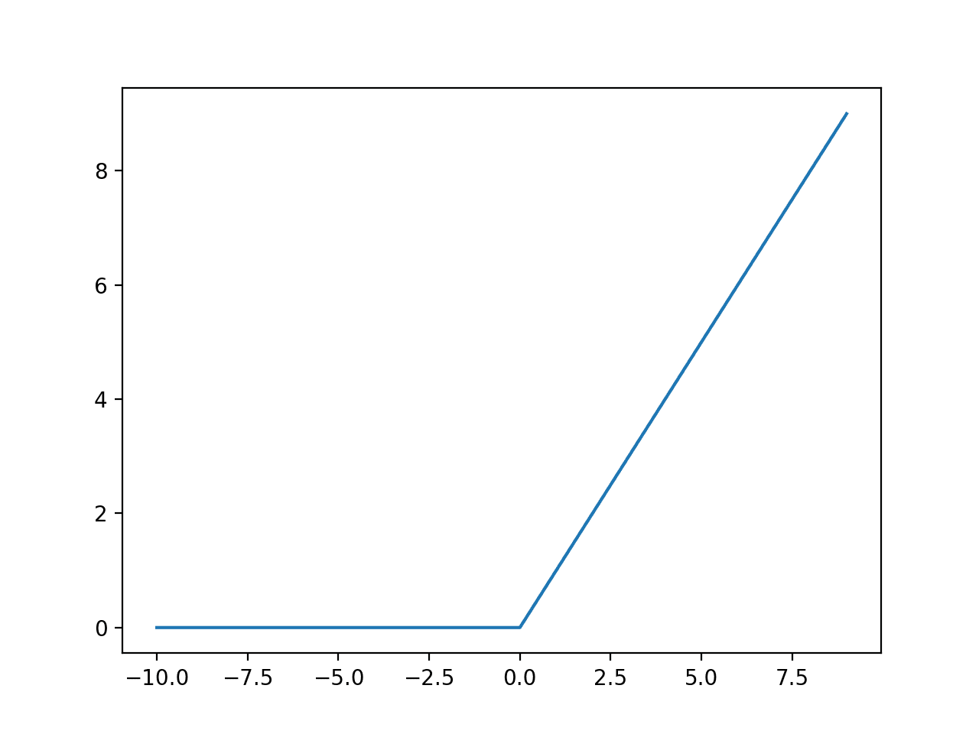
Activation function
The convolutional and dense layer(as hidden layer) use the rectified linear unit(Relu) as their activation function.
Relu is the function that f(x) = max(0,x), where the negative value just becomes 0, and positive number is the number itself
Advantages vs. other activation functions:
Efficiency
No vanishing gradients
When dense layer is the output layer, it uses softmax to find the max value in the result array which predicts the category that is closest to the input

Slide 7
List of models
Model 1 single layer:
convolutional layer-> max-pooling->flatten->dense(output)
Model 2:
2x convolutional layers ->max-pooling->flatten->dense(output)
Model 3 :
2x convolutional layers ->max-pooling->flatten->dense->dropout->dense(output)
Model 4:
2x convolutional layers->max-pooling->
2x convolutional layers->max-pooling->flatten->dense(output)
Model 5:
2x convolutional layers->max-pooling->
2x convolutional layers->max-pooling->flatten->dense->dropout->dense(output)

Slide 8
First attempt
Structure: Convolution, max-pooling, flatten, dense
Image 200x300
flatten
Convolution
(Relu)
Outputs
max-pooling
dense
(softmax)
fully connect

Slide 9
Result: first attempt
Epoch | Time took | loss | accuracy | val_loss | val_accuracy
1 | 183s | 18.4729 | 0.1337 | 2.9286 | 0.4493
2 | 161s | 1.0203 | 0.8039 | 2.9436 | 0.5074
3 | 165s | 0.1877 | 0.9767 | 3.3579 | 0.5166
4 | 175s | 0.0548 | 0.9946 | 3.7252 | 0.4940
5 | 166s | 0.0318 | 0.9973 | 3.4671 | 0.5235
Training accuracy and loss improves significantly in first three epochs(higher accuracy and lower loss)
Validation accuracy improves slightly, and is around 0.5
Overfitting

Slide 10
Adding one more Convolutional layer
Structure: 2x Convolution, max-pooling, flatten, dense
Image 200x300
Outputs
NEW
flatten
max-pooling
Convolution
(Relu)
Convolution
(Relu)
dense
(softmax)
fully connect

Slide 11
Result: 2 convolutional layers
Epoch | Time took | loss | accuracy | val_loss | val_accuracy
1 | 612 | 4.4677 | 0.2570 | 2.3611 | 0.5041
2 | 587s | 0.5460 | 0.8911 | 2.7804 | 0.5447
3 | 593s | 0.0539 | 0.9911 | 2.9356 | 0.5530
4 | 605s | 0.0170 | 0.9982 | 3.2555 | 0.5350
5 | 599s | 0.0135 | 0.9987 | 3.1584 | 0.5484
Training accuracy close to 1
Both loss and accuracy of validation improves
It takes three times longer to train

Slide 12
Adding dropout layer
Structure: 2x Convolution, max-pooling, flatten, dense
NEW
NEW
Outputs
Image 200x300
flatten
Convolution
(Relu)
Convolution
(Relu)
max-pooling
dense
fully connect
dropout
dense
fully connect

Slide 13
Result: two convolutional layers with dropout
Epoch | Time took | loss | accuracy | val_loss | val_accuracy
1 | 1013 | 10.5499 | 0.0904 | 3.3695 | 0.3424
2 | 984 | 3.1911 | 0.3291 | 2.8513 | 0.3880
3 | 965 | 2.4881 | 0.4219 | 2.6099 | 0.4539
...
15 | 899 | 0.2887 | 0.9147 | 3.0062 | 0.5037
16 | 923 | 0.2923 | 0.9176 | 3.1858 | 0.4986
With a dropout layer, 16 epochs before the final model
In the final model, validation loss is higher and validation accuracy is lower
Model is not improved from previous one

Slide 14
Adding one more cycle in feature learning
REMOVED:
Dense+
Dropout layer
NEW
Image 200x300
NEW
NEW
Outputs
flatten
max-pooling
Convolution
(Relu)
Convolution
(Relu)
max-pooling
Convolution
(Relu)
Convolution
(Relu)
dense
(softmax)
fully connect

Slide 15
Result: two cycles no dropout
Epoch | Time took | loss | accuracy | val_loss | val_accuracy
1 | 1212s | 4.3987 | 0.2360 | 2.3943 | 0.4903
2 | 1204s | 1.3791 | 0.6816 | 2.3450 | 0.5244
3 | 1120s | 0.2621 | 0.9368 | 3.4764 | 0.5309
4 | 1145s | 0.0524 | 0.9890 | 3.9383 | 0.5415
5 | 1177s | 0.0166 | 0.9972 | 4.2347 | 0.5450
Validation loss and accuracy are similar to the model with one cycle.
Higher validation loss than one cycle, there is more overfitting
Similar time to train compared to previous on

Slide 16
Adding the dropout layer to two cycles
NEW
NEW
Image 200x300
Outputs
flatten
max-pooling
Convolution
(Relu)
Convolution
(Relu)
max-pooling
Convolution
(Relu)
Convolution
(Relu)
dense
dropout
dense

Slide 17
Result: two cycles with dropout
Epoch | Time took | loss | accuracy | val_loss | val_accuracy
1 | 1781s | 4.2345 | 0.2570 | 3.2379 | 0.3194
2 | 1742s | 3.5747 | 0.3159 | 2.9391 | 0.3677
3 | 1766s | 3.2726 | 0.3820 | 2.5421 | 0.4433
4 | 1751s | 2.8775 | 0.4705 | 2.4949 | 0.4618
5 | 1755s | 2.3542 | 0.5991 | 2.1903 | 0.5106
...
16 | 1784s | 0.0478 | 0.9885 | 2.8247 | 0.5530
17 | 1810s | 0.0333 | 0.9919 | 2.8196 | 0.5576

Slide 18
Comparison of all CNN models
Model | Loss | Accuracy | Val_loss | Val_accuracy | Average category accuracy
One conv. layer | 0.0318 | 0.9973 | 3.4671 | 0.5235 | 0.8283
Two conv. layers | 0.0135 | 0.9987 | 3.1584 | 0.5484 | 0.8362
Two layers with dropout | 0.2923 | 0.9176 | 3.1858 | 0.4986 | 0.8164
Two cycles of two conv. layers | 0.0166 | 0.9972 | 4.2347 | 0.5450 | 0.8347
Two cycles with dropout | 0.0333 | 0.9919 | 2.8196 | 0.5576 | 0.8472

Slide 19
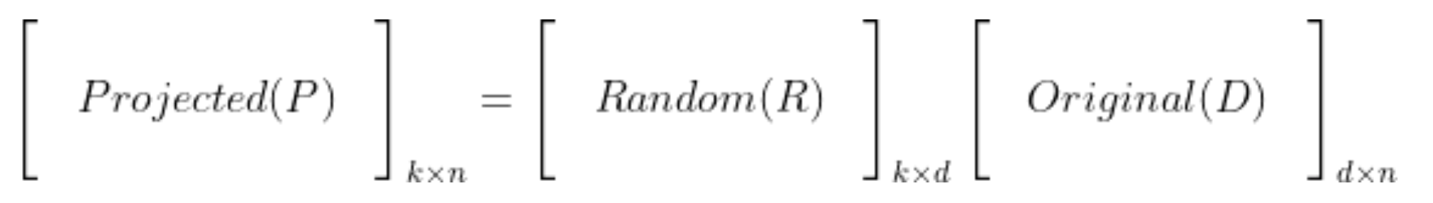
Introduction to Locality Sensitive Hashing: Random Projection Method
Consider a image dataset matrix `D` with `n` vectors of size `d`. This database `D` can be projected onto a lower dimensional space with `n` vectors of size `k` using a random projection matrix.

Slide 20
Ideas behind this method
We construct a table of all possible bins where each bin is made up of similar items. Each bin can be represented by a bitwise hash value so that two images with same bitwise hash values are more likely to be similar than those with different hashes.

Slide 21
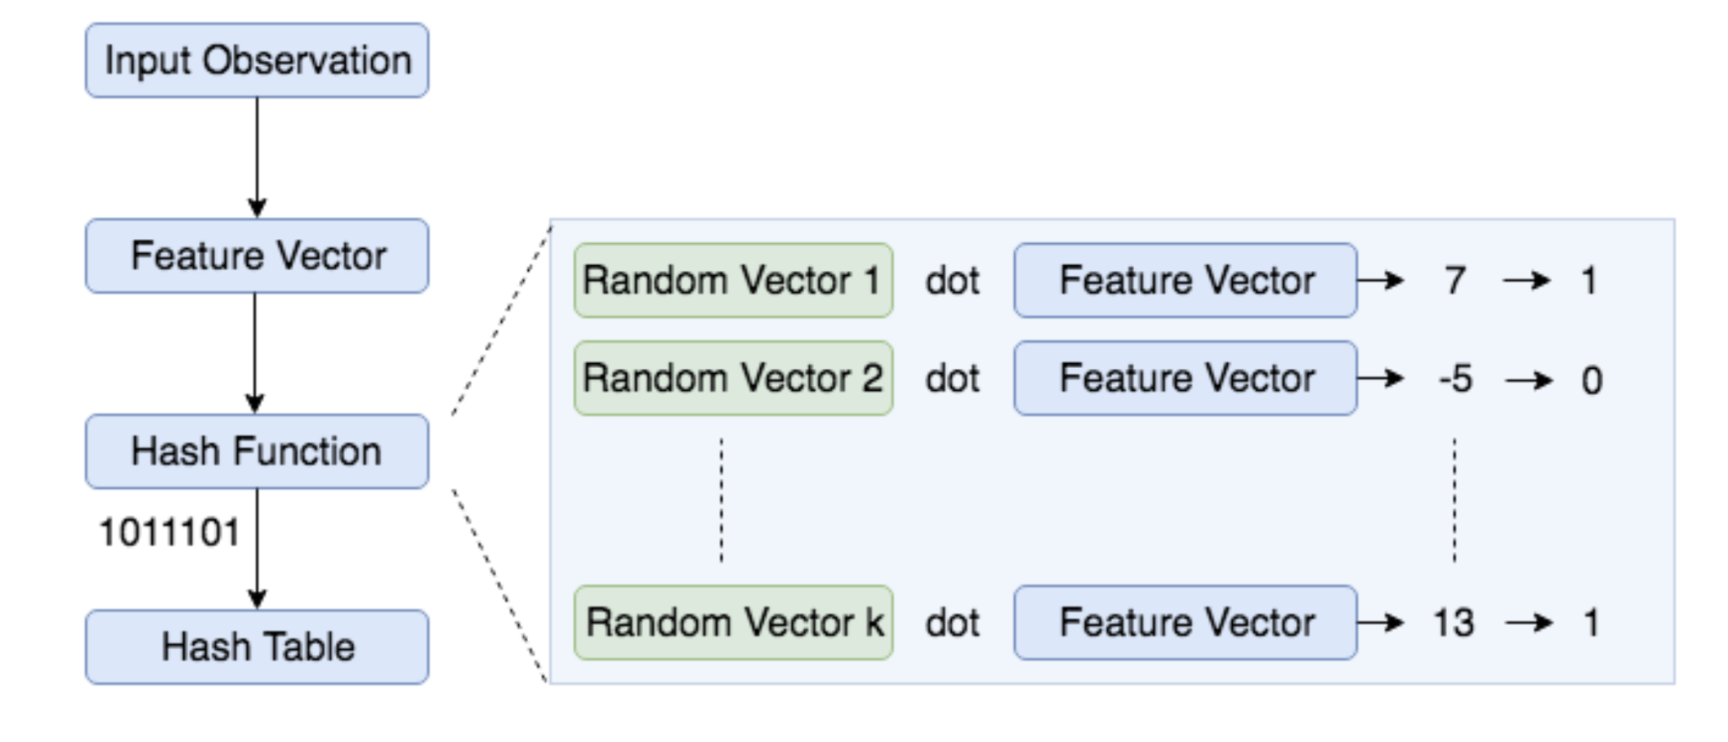
Steps to generate a bitwise hash table
1. Create `k` random vectors of length `d` each, where `k` is the size of bitwise hash value and `d` is the dimension of the feature vector (in our case, this is the dimension of the image).
2. For each random vector, compute the dot product of the random vector and the image. If the result of the dot product is positive, assign the bit value as 1, else 0.
3. Concatenate all the bit values computed for `k` dot products.
4. Repeat the above two steps for all images to compute hash values for all images.
5. Group images with same hash values together to create a LSH table.

Slide 22
Multiple tables
In addition, because of the randomness, it is not likely that all similar items are grouped correctly. To overcome this limitation, a common practice is to create multiple hash tables and consider an image `a` to be similar to image `b`, if they are in same bin in at least one of the tables. It is also worth noting that multiple tables generalize the high dimensional space better and amortize the contribution of bad random vectors.
In practice, the number of hash tables and size of the hash value `k` are tuned to adjust the trade-off between recall and precision.

Slide 23
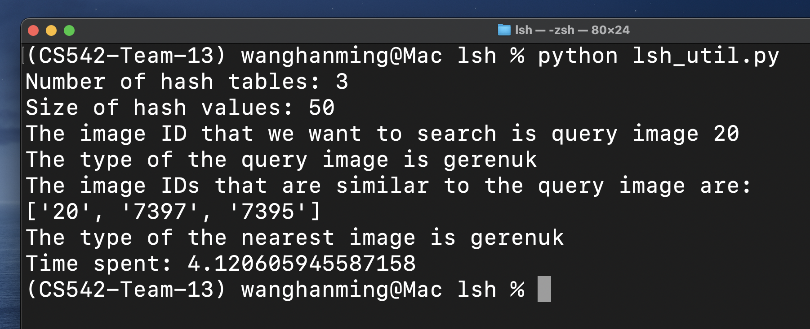
Example output

Slide 24
Resources
https://santhoshhari.github.io/Locality-Sensitive-Hashing/
https://necromuralist.github.io/neural_networks/posts/image-to-vector/
https://docs.python.org/3/tutorial/venv.html
http://www.vision.caltech.edu/Image_Datasets/Caltech101/
https://stackoverflow.com/questions/48121916/numpy-resize-rescale-image
https://github.com/bhavul/Caltech-101-Object-Classification

